Slide 1


Fake reviews detector

Slide 2
Supervisors
Dr. Samar Hesham
lecturer in Egyptian e-learning University
Eng. Almohanad Alaa Eldeen
Teacher assistant in computer and information technology

Slide 3
Team member
Elsayed Mohamed Elfalih (20-00240)
Ayoub Alqas Timothy (20-01214)
Michael ibrahim Fahim (20-00669)
Ahmad Yousry Ahmed (20-00727)
Karim Alaa Elden (20-01662)
Mohamed Maher Abdel-Al (20-00763)
Abanoub Ehab Metry (20-00694)

Slide 4
table of content
Introduction
What is fake reviews ?
Type fo fake reviews
Motivation
Related Work
Login
Dataset
Data analysis
Preprocessing
Machine learing algorithms
Results
API
Home
Review by link
One review Detection
Contact Us
About Us
Register

Slide 5
Introduction
In the digital age, online reviews significantly influence consumer behavior and purchasing decisions. However, the prevalence of fake reviews undermines the credibility of online marketplaces and can mislead consumers. The Fake Reviews Project aims to address this challenge by developing a system that can accurately identify and filter out deceptive reviews using advanced machine learning techniques.

Slide 6
Social experiment
The prevalence of fake product reviews on online platforms, particularly Amazon, poses a significant challenge to consumers seeking reliable information for informed purchasing decisions. A recent survey conducted among 1,000 American individuals preparing to make purchases during the upcoming Amazon Prime Day event has shed light on the concerning confidence levels among consumers regarding their ability to discern authentic reviews.
The survey revealed that a mere 16% of respondents expressed a high level of confidence in their capacity to identify fake product reviews on Amazon. A larger portion, 33%, conveyed only a moderate level of confidence, leaving a substantial 27% with no confidence at all in their ability to distinguish between genuine and deceptive reviews, ultimately impacting their ability to select high-quality products.

Slide 7
The gravity of this issue becomes pronounced when considering that a staggering 78% of participants acknowledged the pivotal role product reviews on Amazon play in shaping their purchasing decisions. The disparity between the reliance on reviews and the perceived ability to differentiate authentic from fraudulent feedback underscores the vulnerability of consumers in the current digital marketplace.
This scenario underscores the urgent need for heightened vigilance and robust measures to combat the proliferation of fake reviews. As consumers heavily lean on online reviews for guidance, the integrity of these platforms becomes paramount. Addressing this challenge is crucial for maintaining trust, fostering fair competition, and ensuring consumers can make well-informed choices based on authentic and reliable information. Platforms, including Amazon, must prioritize the implementation of stringent measures to detect and prevent the circulation of fake reviews, thereby upholding the credibility of their review systems and fortifying consumer confidence in the online shopping experience.

Slide 8

Background
With nearly 80% of customers relying on online reviews before making a purchase, the integrity of these reviews is paramount. Unfortunately, a substantial number of these reviews are fraudulent, created to either promote certain products or to disparage competitors’ offerings1. In 2021 alone, approximately 2.7 million fake reviews were detected, accounting for about 50% of all five-star consumer reviews1.

Slide 9
Objective
The primary goal of this project is to create a robust fake review detection model that can process and classify reviews with high accuracy. By leveraging natural language processing (NLP) and machine learning (ML) algorithms, the system will analyze patterns within the text to distinguish genuine reviews from fake ones.

Slide 10
Significance
The successful implementation of this project will enhance the reliability of online review systems, protect consumers from misleading information, and maintain fair competition among sellers. It represents a step forward in ensuring transparency and trust in e-commerce platforms.

Slide 11
What is a fake review?
A fake review is intentionally deceptive feedback designed to mislead consumers. These reviews don’t accurately reflect the product or service they discuss. Much like “fake news,” they aim to manipulate your decision-making process, often targeting your wallet

Slide 12
Type of fake review
Fake reviews can come in various forms, each with its own characteristics and potential impact on consumer perception. Here are some common types of fake reviews:
Incentivized Reviews: These are reviews where the reviewer is given a reward, such as a discount or a free product, in exchange for writing a positive review.
Review Gating: This occurs when businesses filter out negative feedback by only asking satisfied customers to leave a review.
Paid-for Reviews: Individuals or companies are paid to write positive reviews, regardless of their actual experience with the product or service.
Reviews by Friends and Family: Reviews written by friends or family members of the seller or manufacturer, which are likely to be biased.

Slide 13
Internet Trolls/Fans: Some reviews are written by people who have not used the product but want to affect its ratings due to personal biases.
Disgruntled Customers: Negative reviews that may be exaggerated or untrue, often written by customers who had a bad experience.
Review Flagging: Users falsely report positive reviews as inappropriate to get them removed and lower the product’s ratings.
Competitor Takedown Campaigns: Competitors may engage in writing negative reviews to harm the business of others

Slide 14
Motivation

Slide 15
The impact of fake references on business
The impact of fake reviews on businesses can be significant and multifaceted. Here are some key points highlighting the consequences:
Erosion of Customer Trust: Fake reviews can severely undermine consumer trust in a brand. When customers realize that reviews are not authentic, they may become skeptical of the company’s integrity and the quality of its products or services.
Financial Losses: Businesses may suffer direct financial repercussions due to fake reviews. Misleading positive reviews can lead to customer dissatisfaction and returns, while fake negative reviews can drive potential customers away.

Slide 16
Brand Reputation Damage: The long-term reputation of a brand can be tarnished by fake reviews. This can affect customer loyalty, word-of-mouth referrals, and the overall perception of the brand in the market.
Legal Consequences: Companies found to be soliciting or engaging in fake review practices may face legal action, including fines and penalties, which can further harm the business’s reputation and financial standing.
Manipulation of Search Algorithms: Many e-commerce platforms use customer reviews as a factor in search ranking algorithms. Fake reviews can manipulate these rankings, leading to an unfair competitive advantage or disadvantage.
Challenges in Detection and Remediation: Identifying and addressing fake reviews can be challenging and resource-intensive for businesses. It requires continuous monitoring and may involve the use of advanced technology to detect and manage fake content.

Slide 17
companies caught using fake reviews:
Here are some examples of companies caught using fake reviews:
FTC Crackdown: The Federal Trade Commission (FTC) has been actively targeting deceptive endorsements. In 2021, they sent Notices of Penalty Offenses to over 700 companies, warning them about potential civil penalties (up to $43,792 per violation) if they engage in deceptive practices like fake reviews. These companies span various industries, including large corporations, top advertisers, retailers, and advertising agencies.
Proposed FTC Ban: The FTC is working on a formal ban on fake reviews and testimonials. Businesses caught “buying, selling, and manipulating online reviews” could face fines of up to $50,0002.
Remember, transparency and authenticity are crucial for maintaining consumer trust

Slide 18
company recovering from fake review scandals
One notable case study involves Wells Fargo, a major bank that faced a significant scandal related to fake accounts and unethical behavior. Here’s a summary
Background: Until 2016, Wells Fargo was the world’s largest bank. However, it lost its position due to a large-scale cross-selling scandal. Employees had faked 3.5 million customer accounts to meet short-term sales goals. The bank was fined $185 million by the Consumer Financial Protection Bureau (CFPB) for these unauthorized accounts.
Consequences: Approximately 5,300 employees were fired, and customer trust hit an all-time low. Wells Fargo’s stock price dropped, and new customer accounts declined. Executives were uncertain about the bank’s future growth.

Slide 19
Recovery Efforts:
Culture Change: Wells Fargo had to address its toxic corporate culture that encouraged illicit behavior. It implemented cultural reforms to promote ethical conduct.
Restoring Trust: The bank worked to regain customer and government trust by being transparent about its mistakes and taking corrective actions.
Financial Compensation: Wells Fargo refunded fees associated with unauthorized accounts and terminated employees involved in the scandal.
Long-Term Strategy: The bank focused on rebuilding its reputation and emphasizing ethical practices.
Current Status: While Wells Fargo faced significant challenges, it has made efforts to recover. However, rebuilding trust takes time, and ongoing vigilance is crucial.

Slide 20
OVERVIEW
The project will utilize sentiment analysis, word clouds, and classification algorithms to detect fake reviews. A dataset of reviews will be preprocessed to analyze sentiments, and models like Logistic Regression will be trained for the task. The system will be deployed on a user-friendly interface, providing real-time predictions to assist in identifying deceptive reviews.

Slide 21
Related Work
Review Meta serves as a valuable tool for anyone looking to delve deeper into online product reviews, offering insights that go beyond what is typically displayed on e-commerce platforms.
Eview Meta serves as a valuable tool for anyone looking to delve deeper into online product reviews, offering insights that go beyond what is typically displayed on e-commerce platforms.
Limited to Amazon: Review Meta is primarily designed for Amazon reviews, which means it doesn’t cover other e-commerce platforms. • Complexity: Some users may find Review Meta’s detailed analysis to be complex and difficult to interpret. • False Positives/Negatives: The tool’s algorithm may sometimes incorrectly flag leg
timate reviews as fake or miss deceptive ones. • Length and Specificity: Genuine reviews often include detailed descriptions of personal experiences, while fake reviews might be vague.

Slide 22
Fake spot
FakeSpot utilizes AI technology to evaluate the authenticity of reviews on multiple platforms, with a primary focus on Amazon. Here’s an overview of its features and accessibility
Fake spot provides letter grades that represent the quality of reviews, not the products themselves, which can be confusing for some users. Browser Extension Limitation: While convenient, the browser extension may not always provide the most thorough analysis compared to a full website analysis. Accuracy Concerns: Similar to ReviewMeta, Fakespot’s algorithms can potentially detect deception where it doesn’t exist and miss dishonest reviews

Slide 23
dataset

Slide 24
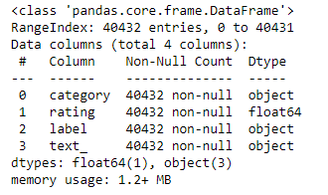
dataset
We've acquired a dataset in Excel format comprising four columns and 40,433 rows, totaling 161,732 cells. Each row contains information on a review, with no empty cells present. The four columns include 'category', 'rating', 'label', and 'text'. The 'rating' column ranges from 1 to 5, representing the review's score, while the 'text' column contains the review comments.

Slide 25
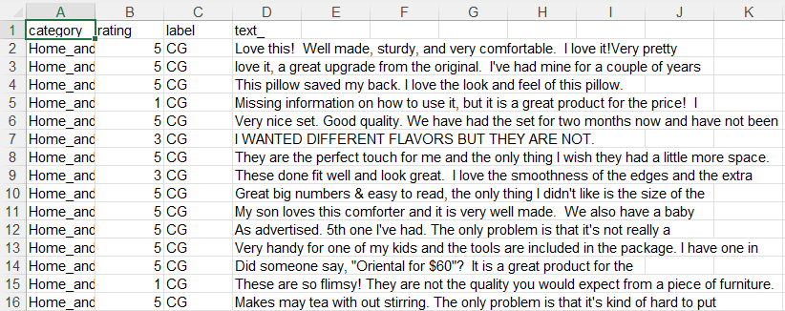
dataset
The dataset is focused on detecting fake reviews within a vast collection of reviews spanning various categories such as Home and Office, Sports, etc. Each review is associated with a corresponding rating and label, where labels denote whether the review is 'CG' (Computer Generated) or 'OR' (Original Review generated by humans).

Slide 26
Data analysis

Slide 27
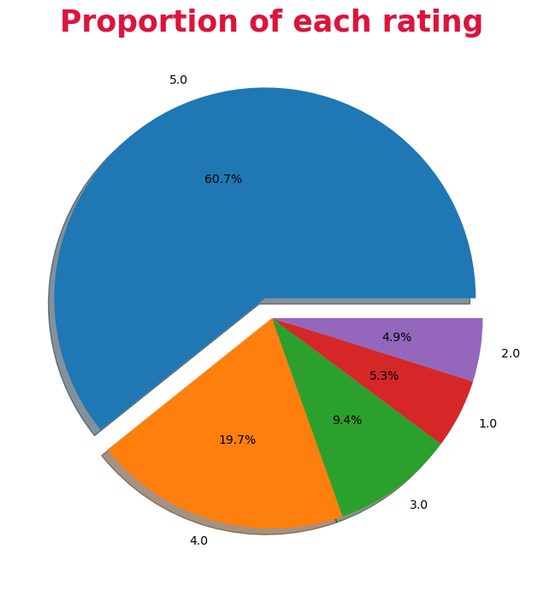
Data analysis
Additionally, there is a percentage breakdown of ratings as depicted in the provided picture.

Slide 28
Preprocessing

Slide 29
Preprocessing
Removing punctuation characters: Eliminating punctuation marks such as ".", ",", "?" simplifies the text and reduces noise.
Transforming text to lowercase: Standardizing the case of text by converting all characters to lowercase ensures consistency in text processing.
Eliminating stopwords: Removing common stopwords like "the", "is", "and", etc., helps in focusing on meaningful words.
Stemming: Reducing words to their root form using stemming (e.g., "running" to "run") reduces the dimensionality of the text data.
29

Slide 30
Preprocessing
Stemming: Reducing words to their root form using stemming (e.g., "running" to "run") reduces the dimensionality of the text data.
Lemmatizing: Similar to stemming, lemmatizing reduces words to their base form, but it does so in a more meaningful way, resulting in more accurate base forms compared to stemming.
Removing digits: Eliminating digits from the text helps in focusing on textual content rather than numerical values.
These text preprocessing techniques are essential steps in preparing textual data for analysis, modeling, or natural language processing tasks. Each technique serves to clean and standardize the text, making it more suitable for downstream processing and analysis.

Slide 31
Machine Learning Algorithms

Slide 32

Machine Learning Algorithms
In this project, we experimented with more than one Machine Learning algorithm, and in the end, we identified two of them that can be used in the project.
Support Vector Machines
Random Forest Classifier

Slide 33
results
Logistic Regression Prediction Accuracy: 86.05%
K Nearest Neighbors Prediction Accuracy: 57.66%
Decision Tree Classifier Prediction Accuracy: 73.34%
Random Forests Classifier Prediction Accuracy: 87.56%
Support Vector Machines Prediction Accuracy: 88.11%
Multinomial Naive Bayes Prediction Accuracy: 84.35%

Slide 34
Support Vector Machines
Support Vector Machines (SVMs) are effective for evaluating fake reviews due to several reasons:
1. Effective Binary Classification: SVMs are inherently designed for binary classification, making them suitable for distinguishing between fake and genuine reviews.
2. Handling Large and High-Dimensional Datasets: SVMs perform well with large volumes of high-dimensional data, ideal for review datasets.
3. Robustness to Overfitting and Noise: SVMs can handle noisy data well and reduce the impact of overfitting.
4. Flexibility in Kernel Selection: Different kernel functions allow SVMs to capture complex data relationships.
5. Precision in Decision Boundaries: SVMs find decision boundaries with maximum margin, aiding in clear separation between classes.

Slide 35
Random Forest Classifier
Random Forest Classifier is advantageous for determining fake reviews due to the following reasons:
1. Ensemble Learning: Combines multiple decision trees for more accurate and robust predictions.
2. Handling High-Dimensional Data: Effective with high-dimensional text-based datasets.
3. Feature Importance: Provides insights into which features are most significant in distinguishing fake from genuine reviews.
4. Handling Imbalanced Data: Can manage imbalanced datasets by adjusting class weights or using bootstrapping.
5. Parallelization: Easily parallelizable, allowing efficient training on large datasets.
6. Ease of Use: Requires minimal hyperparameter tuning and is user-friendly.

Slide 36
Flask
We created a server using Flask to handle different URLs. Flask provides comprehensive tools for handling HTTP requests and responses, including form data, file uploads, cookies, and more. Additionally, Flask supports server-side sessions to store data across requests, enhancing user experience and effective data management.

Slide 37
Web Scraping
We used web scraping to simplify the process for the user. If a user has multiple comments on an Amazon product and wants to verify their authenticity, instead of entering each comment manually, they can simply provide the link. Web scraping will then automatically retrieve the comments.

Slide 38
Data Extraction
A table has been constructed to compile comments extracted from the Amazon website, streamlining the process of identifying genuine and fake reviews. Within this setup, a loop has been established to systematically include each comment's content, date of posting, and associated rating.

Slide 39
Clean Text
Initially, the text undergoes normalization by mapping all letters from A to Z. Subsequently, all uppercase letters are converted to lowercase, and their frequencies are computed. Stop words are then identified and eliminated from the text to facilitate meaningful comparisons with the dataset.

Slide 40
Predict Fake Reviews
Each review's text review Review Body is cleaned using a preprocessing function clean text. This step ensures uniformity and removes noise from the text data.
The cleaned reviews are transformed into numerical feature vectors using a vectorizer (`vectorizer`). This process converts text data into a format suitable for machine learning models to process.
The transformed data (`X`) is fed into a pre-trained machine learning model (`model`) to make predictions.
The model predicts whether each review is likely to be fake or genuine based on the patterns learned during training.
Predictions for each review are returned as the output of the function.

Slide 41
API
It's a set of rules and protocols that allows different software applications to communicate with each other.
APIs define the methods and data formats applications can use to request and exchange information.
Clients send requests to APIs, and APIs respond with data or actions, typically in a structured format like JSON

Slide 42
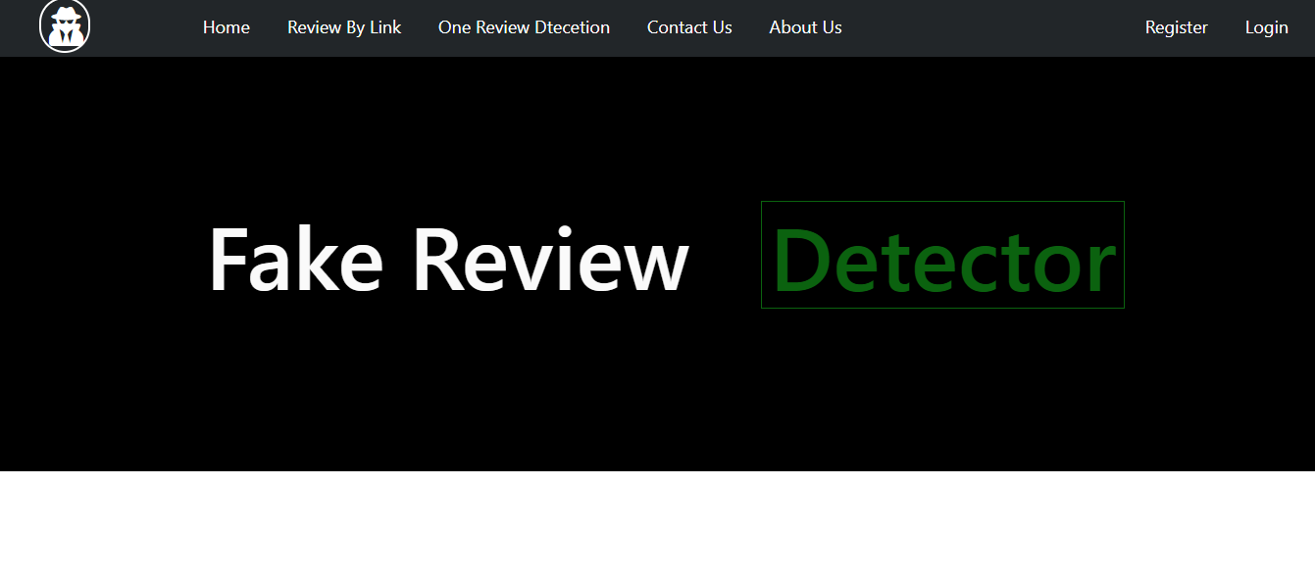
Top navigation menu
Home
Review by link
One review Detection
Contact Us
About Us
Register
Login

Slide 43
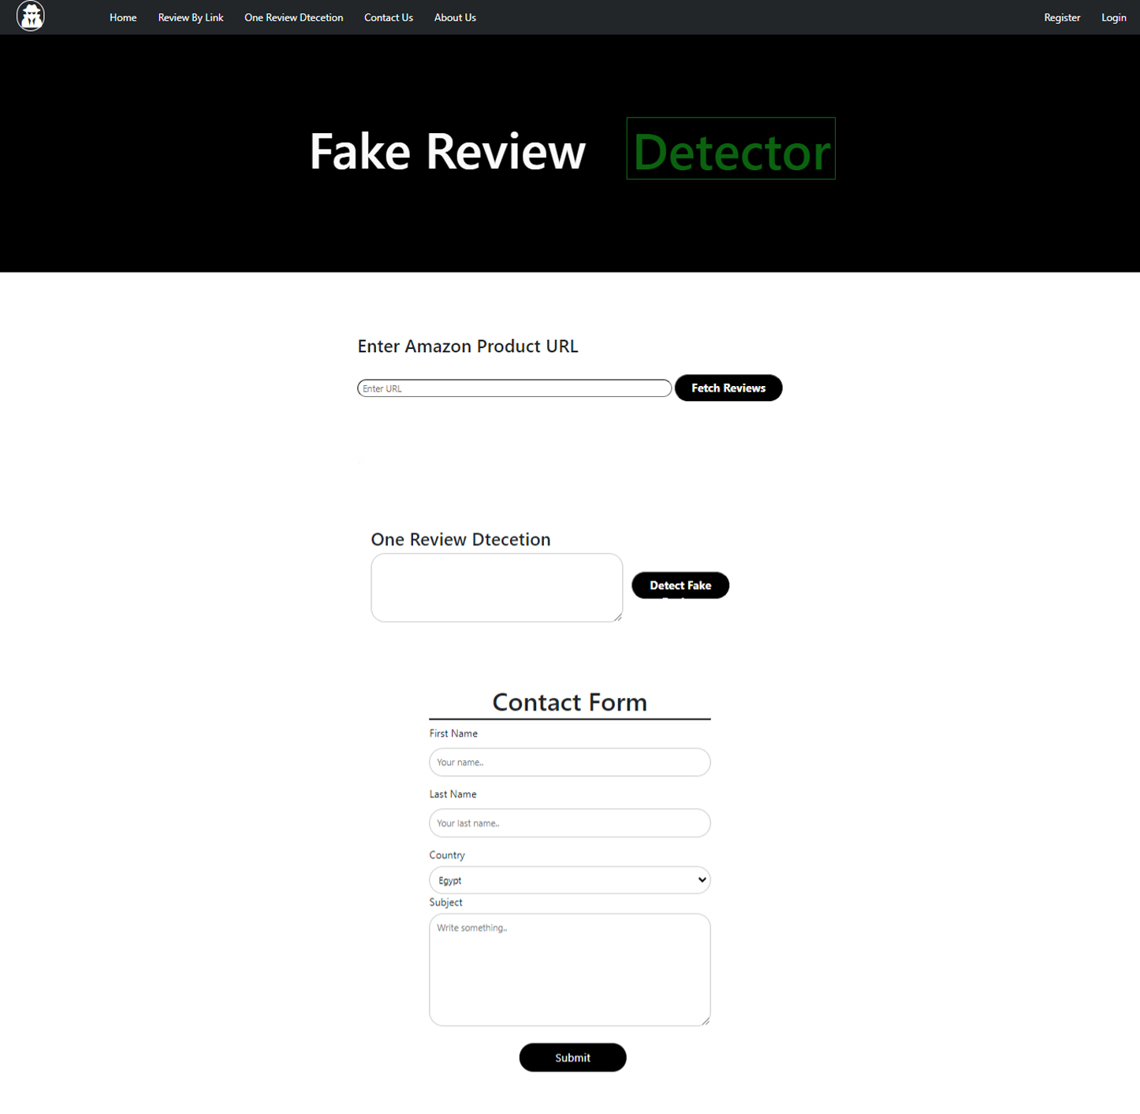
“Home Page ”

Slide 44
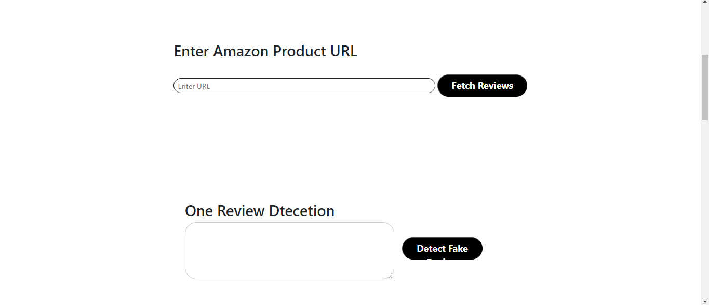
Amazon Review Detection Page
Enter Amazon Product URL Field: A text input where users can enter the URL of an Amazon product.
One Review Detection Section: A text input area where users can enter a single review.
This page allows users to input an Amazon product URL to fetch and analyze multiple reviews for potential fakeness, or to manually input a single review for analysis.

Slide 45
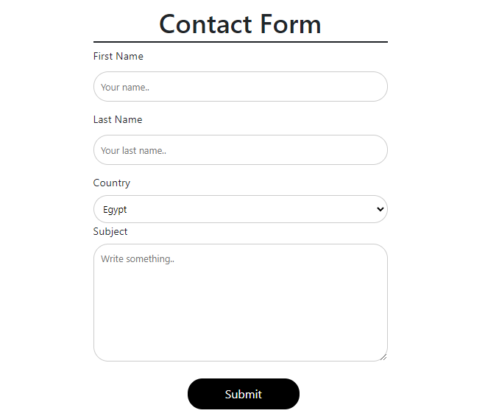
Contains fields for the user to fill out: - First Name - Last Name - Country: Select his country from the dropdown list. - Subject: Write his message
Contact Form

Slide 46
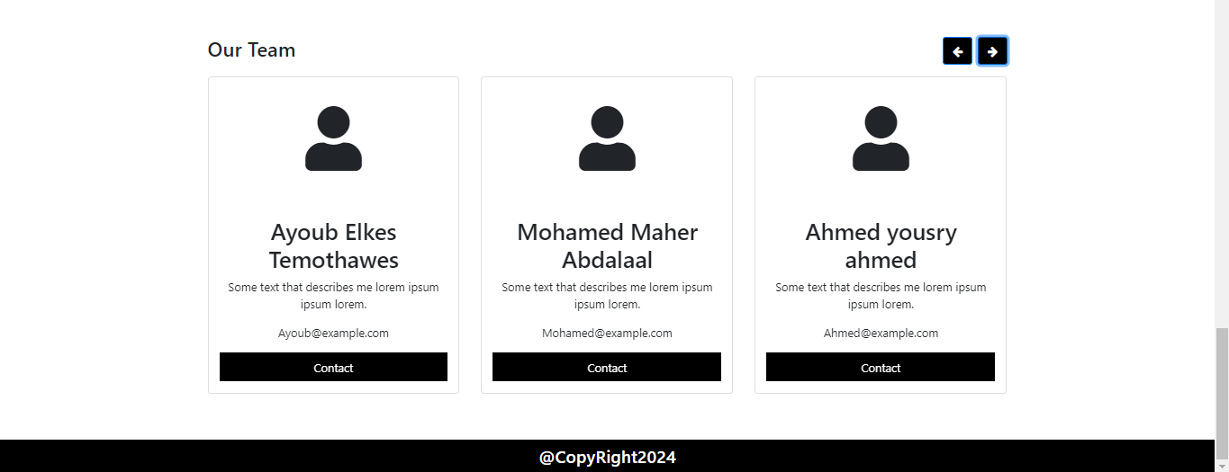
- Team Members: Contains cards for team members with their contact information (E-mail )
About US

Slide 47
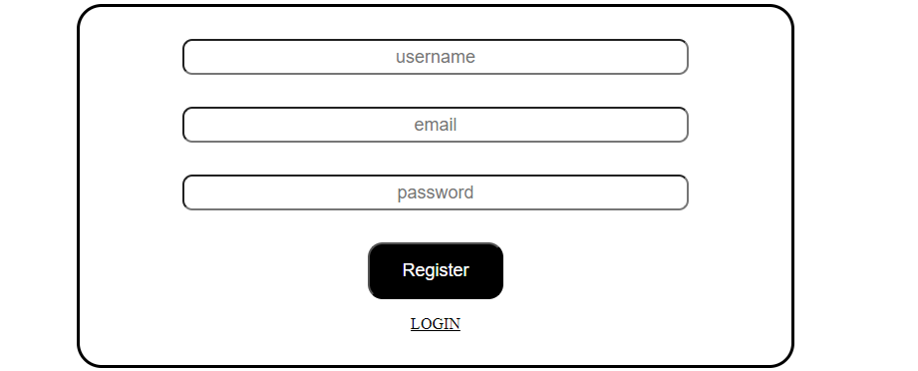
-Username Field
-Email Field -Register Button -Login Link: A link that redirects users back to the login page if they already have an account.
Registration Page

Slide 48
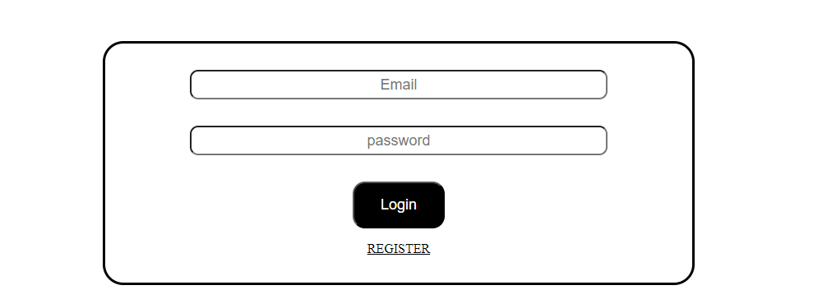
-Email Field -Password Field -Login Button -Register Link: A link that redirects users to the registration page if they don't have an account.
Login Page

Slide 49
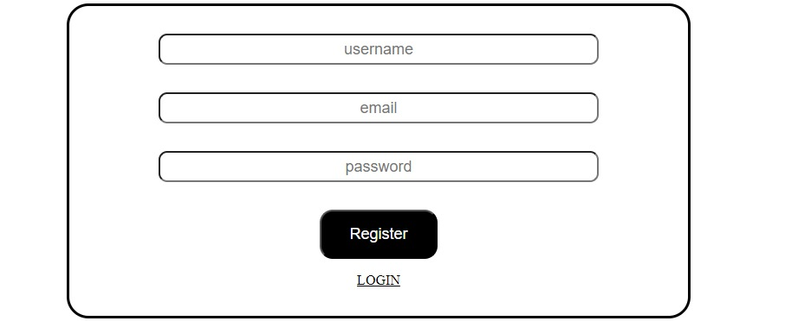
Registration Page
Description: This screenshot shows the user registration page. It includes fields for the username, email, and password, and a "Register" button to create a new account. There is also a "Login" link for users who already have an account

Slide 50
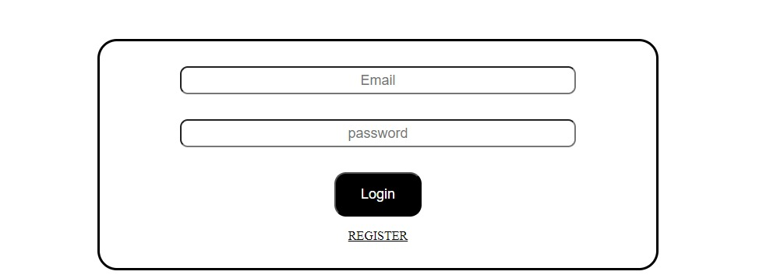
Login Page
This screenshot displays the user login page. It has fields for the email and password, along with a "Login" button for user authentication. Additionally, there is a "Register" link for new users to create an account.

Slide 51
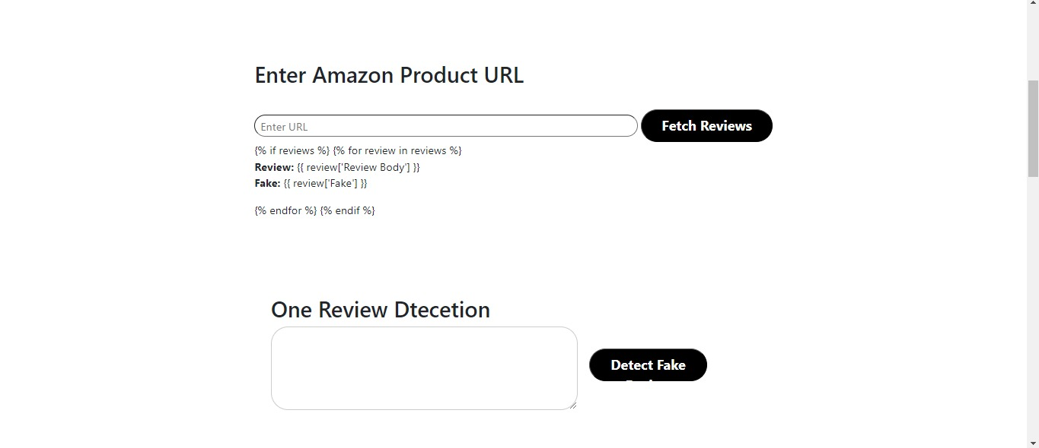
Review Detection Page
This screenshot depicts the review detection page. Users can enter an Amazon product URL to fetch reviews by clicking the "Fetch Reviews" button. There's also a section for detecting if a single review is fake by entering the review text and clicking the "Detect Fake" button

